Slide 1
Magnet
A Neural Network for Directed Graphs
Yuting Hu
yhu54@buffalo.edu

Slide 2
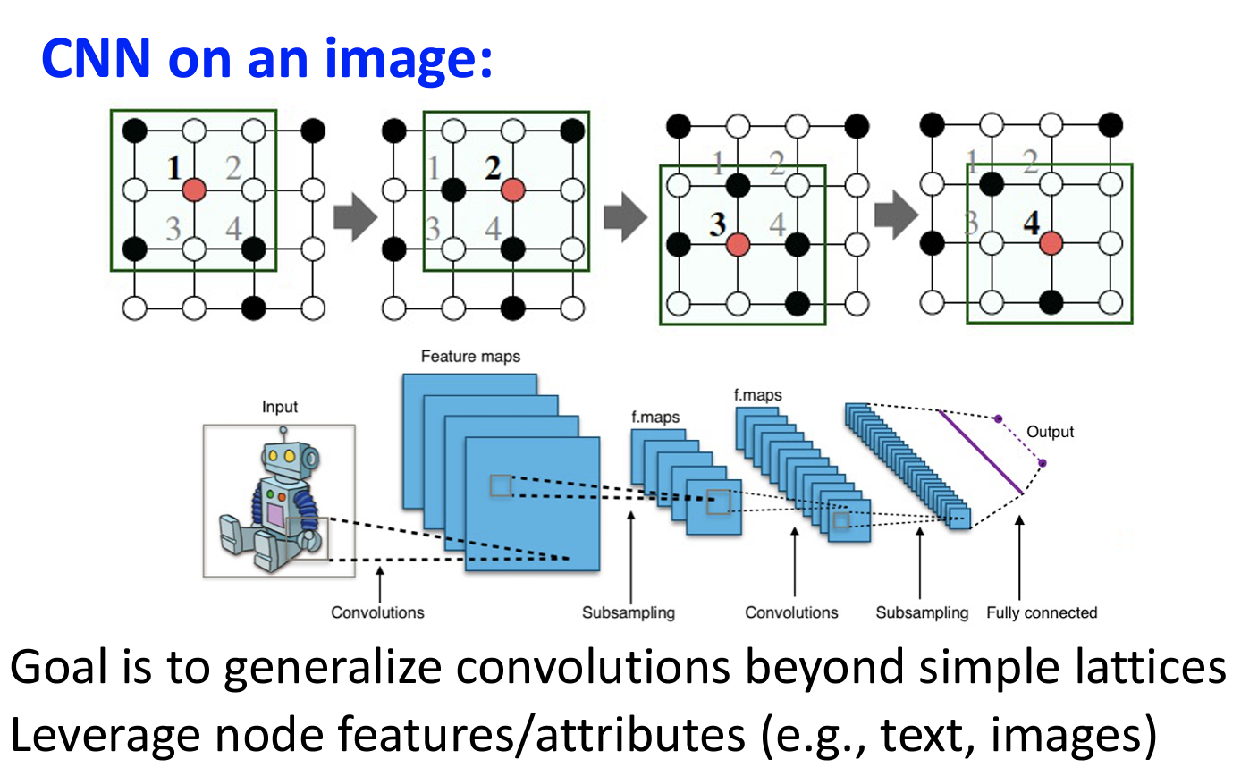
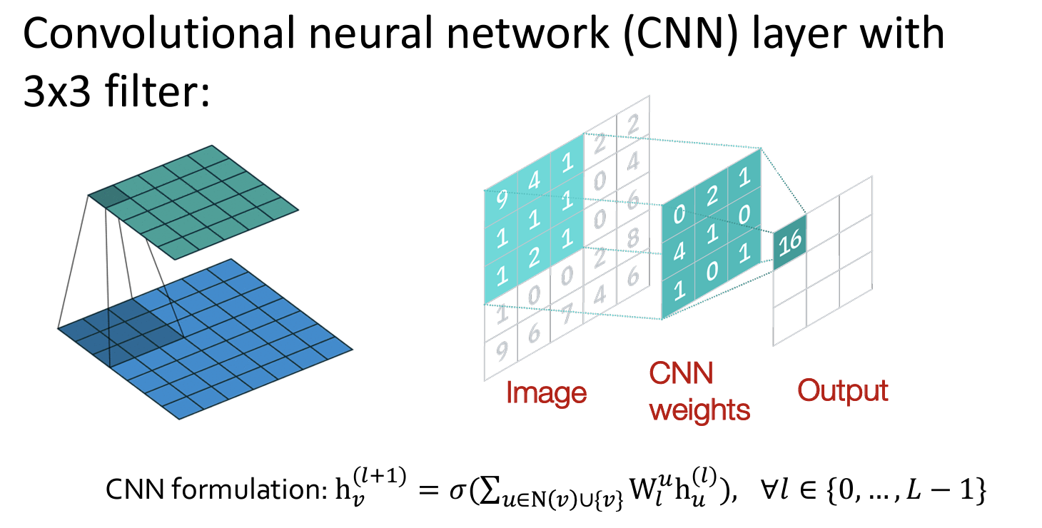

Slide 3
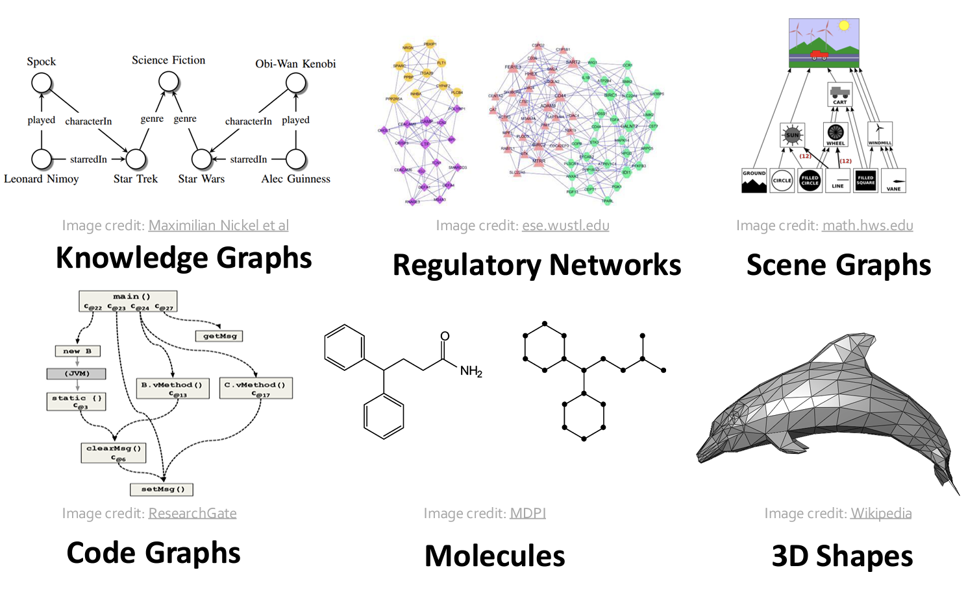
Many Types of Data are Graphs

Slide 4
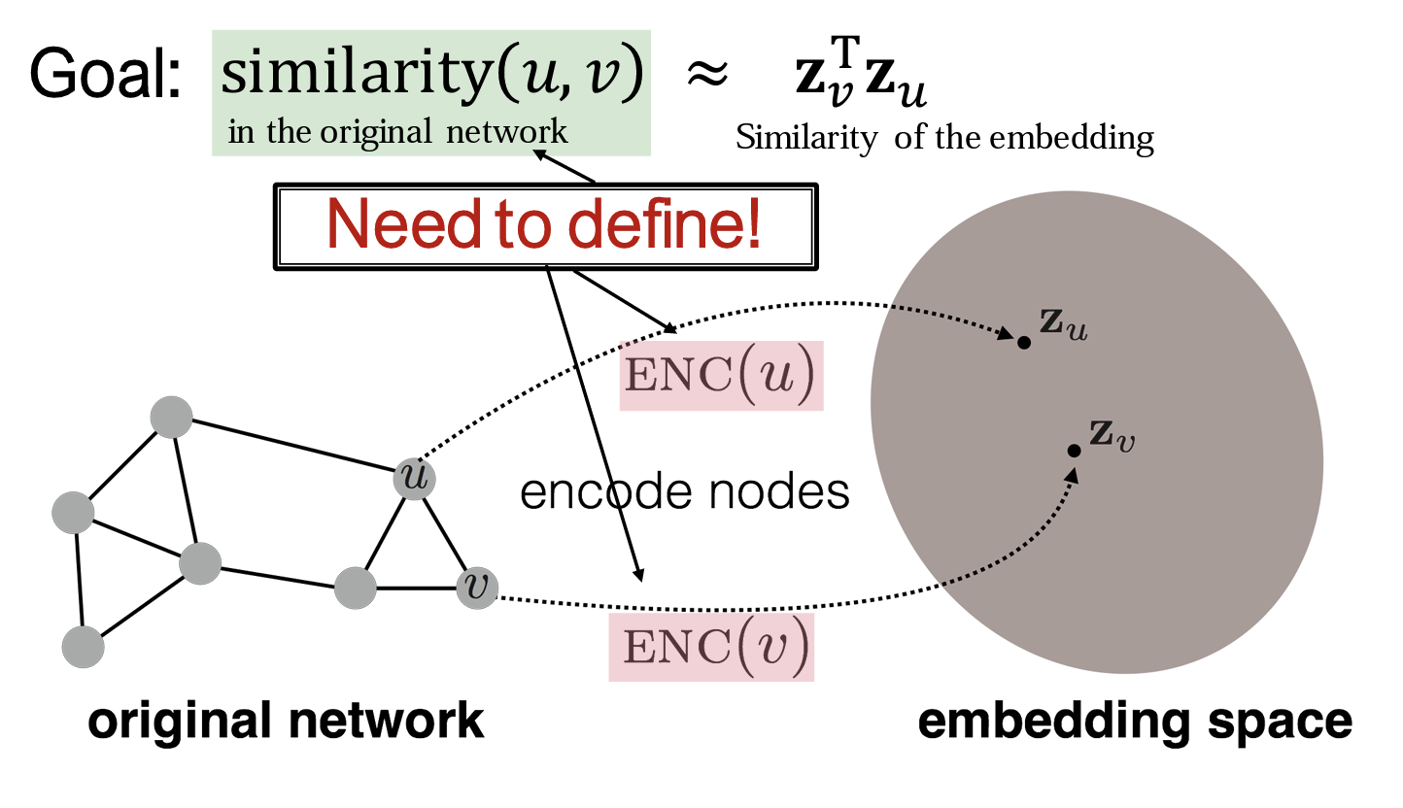
How to map nodes into an embedding space using convolution?
Spatial-Methods
Spectral-Methods
Generalize the concept of convolution to graphs
Back to the definition of convolution in signal processing

Slide 5
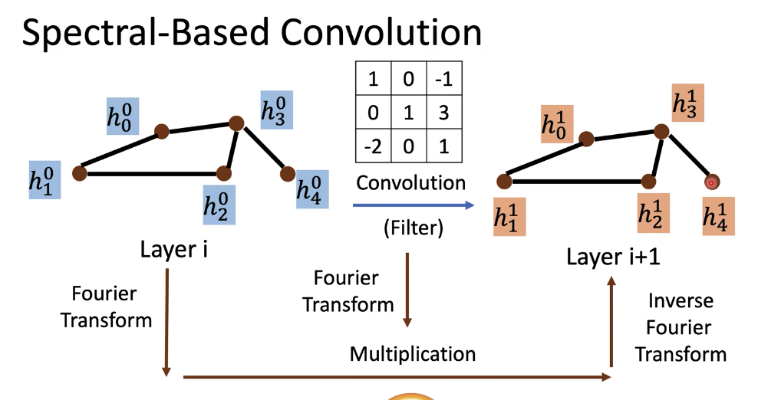
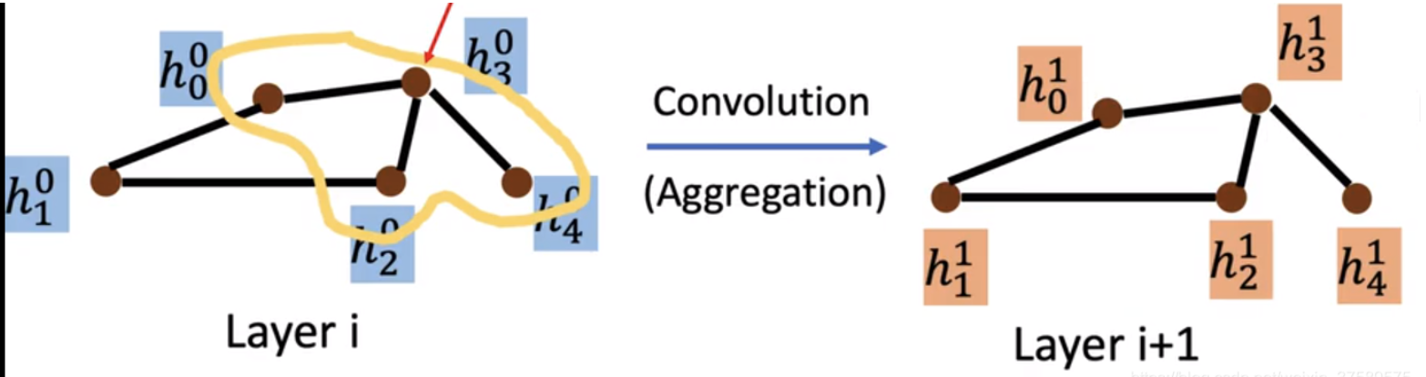
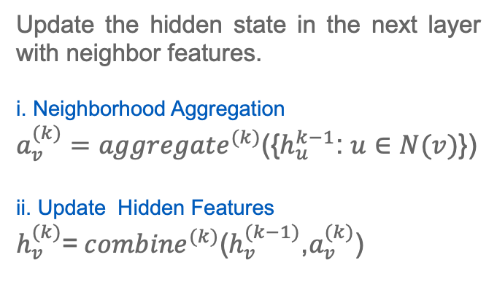
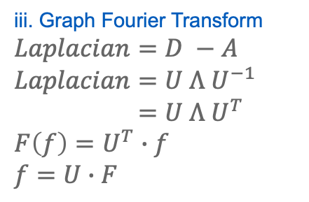
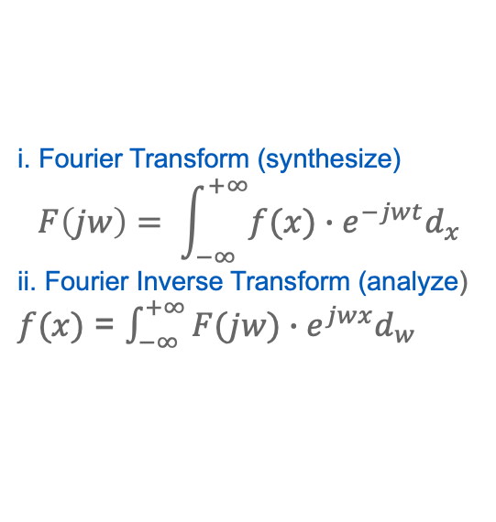
Spatial-Based GNN
Spectral-Based GNN
Update the hidden state in the next layer with neighbor features.
i. Neighborhood Aggregation
$a_{v}^{(k)}={aggregate}^{(k)}$({$h_{u}^{k−1}$: $u∈N(v)$})
ii. Update Hidden Features
$h_{v}^{(k)}$=${combine}^{(k)}$($h_{v}^{(k−1)}$,$a_{v}^{(k)}$)
i. Fourier Transform (synthesize)
$$F\left(jw\right)= \int_{−∞}^{+∞}{f(x)∙e^{−jwt}d_{x}}$$
ii. Fourier Inverse Transform (analyze)
$f(x)$ = $\int_{−∞}^{+∞}{F(jw)}∙e^{jwx}d_{w}$
iii. Graph Fourier Transform
$$Laplacian=D −A$$
$$Laplacian=U Λ U^{−1}$$
$=$ $U Λ U^{T}$
$$F\left(f\right)=U^{T}∙f$$
$$f=U∙F$$
$$F\left(f∗g\right)=F\left(f\right)∙F\left(g\right) f∗g= F^{−1}(F\left(f\right)∗F(g))$$
Message passing and neighborhood aggregation information across the graph
Project the graph signal into spectral domain, then reproject it back

Slide 6
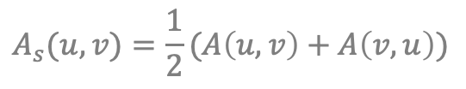
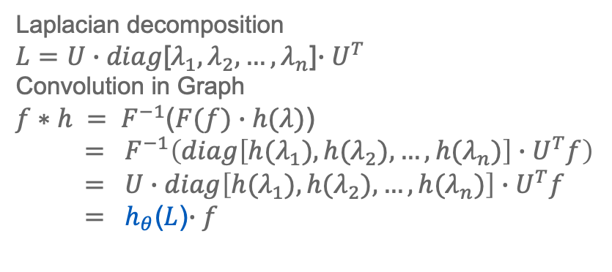
The Limits of Spatial & Spectral Methods on Directed Graphs
Spatial methods : always neglect the incoming neighbors even it’s potentially important.
Spectral methods : the adjacency matrix A of the directed graph are asymmetric, the eigen-decomposition of
Laplacian cannot generate a set of real eigenvalues.
n₃
$$A_{s}(u,v)=\frac{1}{2}(A\left(u,v\right)+A\left(v,u\right))$$
n₃
n₂
n₂
n₁
n₁
Laplacian decomposition
$L=U∙diag$[$λ_{1},λ_{2},…,λ_{n}$]$∙U^{T}$
Convolution in Graph
$f∗h = F^{−1}$($F(f)∙h(λ)$)
$= F^{−1}\left({diag\left[{h(λ}_{1}),{h(λ}_{2}),…,h(λ_{n})\right]∙U}^{T}f\right)$
$= U∙diag\left[{h(λ}_{1}),{h(λ}_{2}),…,{h(λ}_{n})\right]∙U^{T}f$
$= h_{θ}$($L$)$∙f$
Laplacian of Undirected Graph
symmetric
positive-semidefinite
has an orthonormal basis of eigenvectors
positive eigenvalues

Slide 7
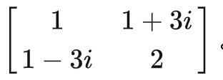
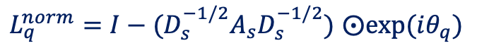
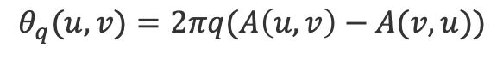
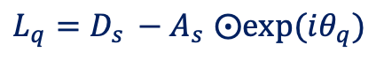
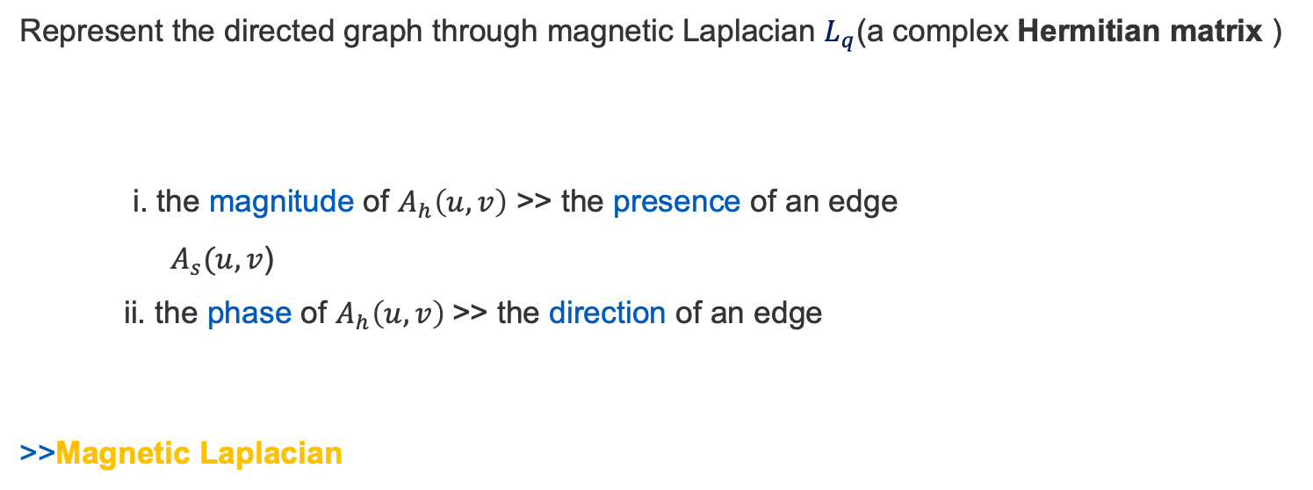
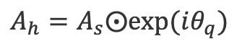
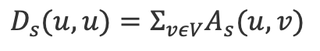
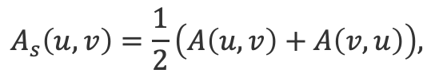
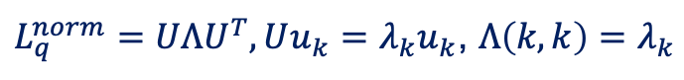
Magnet—Extending Spectral Methods to Directed Graphs via Magnetic Laplacian
Represent the directed graph through magnetic Laplacian $L_{q}$(a complex Hermitian matrix )
i. the magnitude of $A_{h}\left(u,v\right)$ >> the presence of an edge
${ A}_{s}(u,v$)
ii. the phase of $A_{h}\left(u,v\right)$>> the direction of an edge
>>Magnetic Laplacian
$$A_{s}\left(u,v\right)=\frac{1}{2}\left(A\left(u,v\right)+A\left(v,u\right)\right),$$
$$D_{s}(u,u)=Σ_{vεV}A_{s}(u,v)$$
All the eigenvalues are real.
All the eigenvectors are orthogonal.
If A is Hermitian, then A^{k} is Hermitian.
$$A_{h}=A_{s}⨀exp⁡(iθ_{q})$$
$θ_{q}(u,v)=2πq(A\left(u,v\right)−A(v,u))$
$L_{q}=D_{s }−A_{s}$ $⨀exp⁡(iθ_{q})$
$L_{q}^{norm}=I−(D_{s}^{−1/2}A_{s}D_{s}^{−1/2})$ $⨀exp⁡(iθ_{q})$
symmetric
positive-semidefinite
diagonalized
$L_{q}^{norm}=UΛU^{T}, Uu_{k}=λ_{k}u_{k}$, $Λ\left(k,k\right)=λ_{k}$

Slide 8
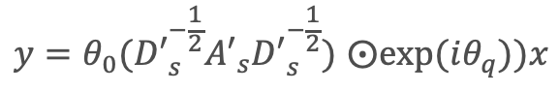
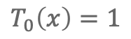
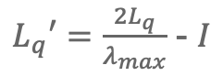
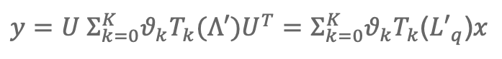
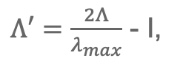
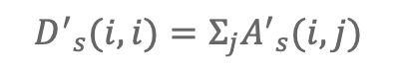
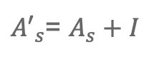
Graph Spectral Convolution via Magnetic Laplacian
ChebNet
GCN
$$y=θ_{0}({D′}_{s}^{−\frac{1}{2}}{A′}_{s}{D′}_{s}^{−\frac{1}{2}}) ⨀exp⁡(iθ_{q}))x$$
$y=U Σ_{k=0}^{K}{θ_{k}T_{k}(Λ′)U^{T}=Σ}_{k=0}^{K}θ_{k}T_{k}$(${L′}_{q}$)$x$
$Λ′=\frac{2Λ}{λ_{max}}$ - I,
$L_{q}′=\frac{2L_{q}}{λ_{max}}$ - $I$
${A′}_{s}$= $A_{s}+I$
$$T_{0}\left(x\right)=1$$
$${D^{′}}_{s}(i,i)=Σ_{j}{A^{′}}_{s}(i,j)$$
$$T_{1}\left(x\right)=x$$
...
$T_{n+1}\left(x\right)=2xT_{n}\left(x\right)$ - $T_{n−1}\left(x\right)$

Slide 9
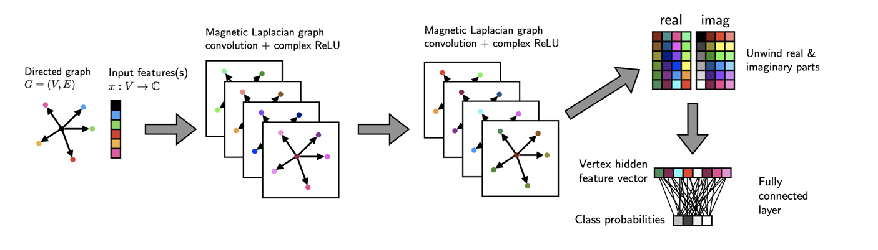
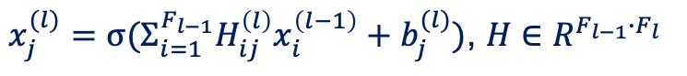
Magnet Structure
$x_{j}^{(l)}=σ(Σ_{i=1}^{F_{l−1}}H_{ij}^{\left(l\right)}x_{i}^{\left(l−1\right)}+b_{j}^{(l)})$, $H∈R^{F_{l−1}∙F_{l}}$

Slide 10
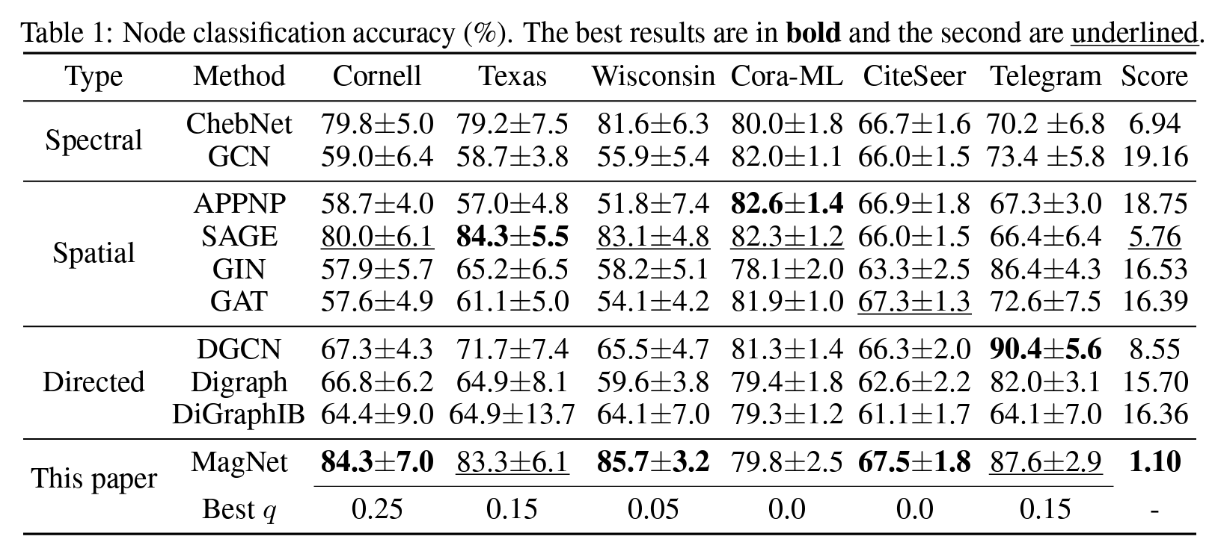
Performance

Slide 11
THANK You
Any Questions?

